Slide 1
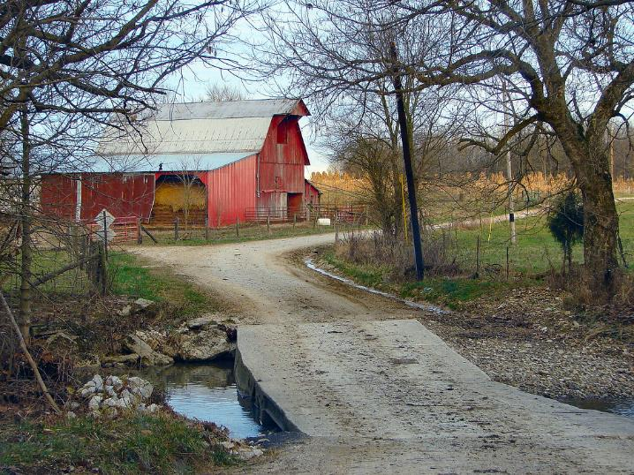
Understanding
Heirs’ Property at the
Community Level
August 28, 2024
Virginia State University
Small Farm Outreach Program
VSU Pavalion
Randolph, VA
Notes:
Instructions: Before the session begins, insert the date and location for your event. Have this slide up as participants enter the room.
Please acknowledge that this material was developed in partnership with the Socially Disadvantaged Farmers and Ranchers Policy Center at Alcorn State University, The Southern Extension Risk Management Education, and the Southern Rural Development Center through funding in part from USDA.
NOTE: If you do not do all three segments at the same event, insert slides 1-4 at the beginning of your other sessions as they provide the overarching foundation for the training.
Time: 1 minute
Materials: none
Handouts: None

Slide 2
Purpose:
To prepare Extension/outreach professionals to disseminate training on heirs’ property to communities and individuals.
Notes:
Instructions: Explain the purpose of the overall curriculum.
Time: 1 minute
Materials: none

Slide 3
Important Notes before We Begin: These materials are intended to present general information as to preventing heirs’ property. They primarily draw upon information in the southern United States. The information may not be applicable to every state or territory. These materials do not provide legal advice. Specific advice should be obtained from an attorney or another professional well versed in the facts and circumstances related to the individual seeking advice and the jurisdiction where the property is located.
Notes:
Instructions: Read the disclaimer and answer any questions that may arise.
Time: 1 minute
Materials: none
Handouts: none

Slide 4
Acknowledgements
Primary Authors
Andrea’ Barnes, Esquire
Mississippi Center for Justice
Gloria Bromell Tinubu, PhD
GBT Associates, LLC
Robert Zabawa, PhD
Tuskegee University
Contributors and Reviewers
Conner Bailey, PhD, Professor Emeritus, Auburn University
Sam Cook, Executive Director of Forest Assets, North Carolina State University
Savi Horne, Esquire, Executive Director, Land Loss Prevention Project
Lorette Picciano, Executive Director, Rural Coalition
Kara Woods, PhD, Policy Analyst, SDFR Policy Research Center, Alcorn State University
Notes:
Instructions: Please acknowledge the primary and contributing authors to this material as well as the funding stream through the Southern Rural Development Center and the Socially Disadvantaged Farmers and Ranchers Policy Research Center at Alcorn State University.
Time: 1 minute
Materials: none
Handouts: none

Slide 5
Notes:
Instructions: Give time for participants to introduce themselves. You could also include a brief question for them to answer such as what is one question or curiosity you have about heirs’ property. Don’t take time to answer those at this point. Rather this is about acknowledging where their curiosities are, and how the group can share this time together to learn and support each other.
Time: 1 minute
Materials: none

Slide 6
Topics to Explore
OVERVIEW | Heirs’ property definition
 | How heirs’ property is identified
 | Factors associated with the prevalence of heirs’ property
 | Impacts of heirs’ property
 | Relationship between tax sales, partition sales, and land loss
 | Laws, policies, and programs relevant to heirs’ property
PREVENTION | Basics of estate and succession planning
 | Steps to prevent heirs’ property when establishing a will
RESOLUTION | Review some of the challenges of owning heirs’ property
 | Importance of working with other family members
 | Steps to take to understand who legally owns the property
 | Legal structures that can hold land owned by heirs’ property owners
Notes:
Instructions: This slide shows the three parts of the curriculum and gives a quick view of the components covered in each section.
Time: 1 minute
Materials: none

Slide 7
SESSION OVERVIEW
What is Heirs’ Property
Basics of Estate Planning/Succession Planning
Preventing Heirs’ Property When Writing Your Will
Title to Real Property
Working with an Attorney
Notes:
Instructions: Use the talking points on the slide to provide an overview of this session.
Time: 1 minute
Materials: none
Handouts: none

Slide 8
WHAT IS HEIRS’ PROPERTY?
Notes:
Total Session Time: 3 hours
Instructions: Have this slide up when participants enter the room.
Time: 1 minute
Materials: none
Handouts: none

Slide 9
What is Heirs’ Property?
Refers to property passed down informally from generation to generation
The original landowner dies without a will, or the will was not probated or administered
State laws determines who inherits your land.
Can potentially include multiple generations and hundreds of relatives
No single heir has clear title to the entire parcel.
Notes:
Instructions: Using the talking points on the slide, give a brief overview of what is meant by heirs’ property.
Everyone gets their interest in the property. The interest amount is determined by heirship.
A person is not an heir until their previous generation has passed.
No matter what the interest size, each person is a co-owner, and all co-owners have the same amount of right (legally) to do or not do anything to the land. This will be explained more in the family tree section later in this presentation.
Time: 2 minutes
Materials: none
Handouts: none

Slide 10
DECEDENT
INTESTATE
HEIRS
Death of a property holder
Lack of a will
KEY TERMS
Family members related by blood, adoption, and/or marriage who inherit by law.
Notes:
Instructions: The three terms on the slide provide a basis for the overview.
Heirs’ property refers to, in this case, real property that is owned by someone who dies (decedent), without a will (intestate), and who has surviving family members (heirs). The state in which the decedent lived probates the property in lieu of a will or other estate plan.
Heirs cannot be determined until the death of the decedent.
Time: 2 minutes
Materials: None
Handouts: None

Slide 11
Important
If you do not decide
how you want your estate divided,
the state where your property is located will divide based on intestate succession law
Notes:
Instructions: This important note helps set the stage for why this education is needed. No one wants the state to make the final decision on how their estate is divided after their death.
Time: 1 minute
Materials: None
Handouts: None

Slide 12
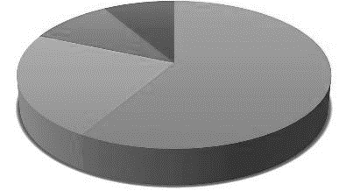
Fractional Ownership
The SIZE of each heirs’ fractional ownership interest depends on several factors such as:
How many generations removed is an heir from the original deceased landowner?
How many heirs can rightfully take their inheritance at a specific point in time?
Notes:
Instructions: Heirs’ property means that heirs have an undivided fractional interest in the land. Fractional here means a percentage interest as opposed to actual acreage. Note these two key factors that influence fractional interest. These are discussed further in the next slide.
Time: 1 minute
Materials: None
Handouts: None

Slide 13
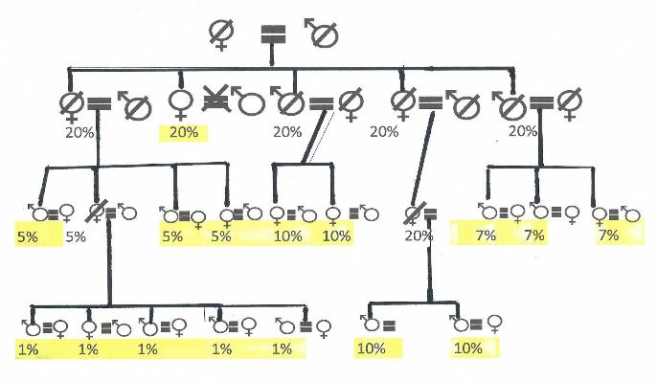
Time: Across Generations, Things Get Complicated!
Parents
Children
Grandchildren
Rounded
Great-grandchildren
Notes:
Instructions:
In this example, the diagram shows three generations of heirs, with more people in each generation having a smaller fractional interest. Each generation gets a percentage of their parents’ share. So, in this example, the five children each had 20%. But as they pass away, their percentage is divided among their respective children. So here, the differences are:
Generation 1 (children) – 1 heir surviving at 20%
Generation 2 (grandchildren) - 8 heirs surviving, with 10%, 7% (rounded), and 5%
Generation 3 (great-grandchildren) - 7 heirs surviving, with 10% and 1%.
In all, there are 22 heirs, 16 heirs surviving, across three generations, with fractional interests ranging from 20% to 1%.
NOTE: Remember, although not depicted here, a spouse of a deceased heir may inherit that person’s share.
Time: 10 minutes
Materials: None
Handouts: None

Slide 14
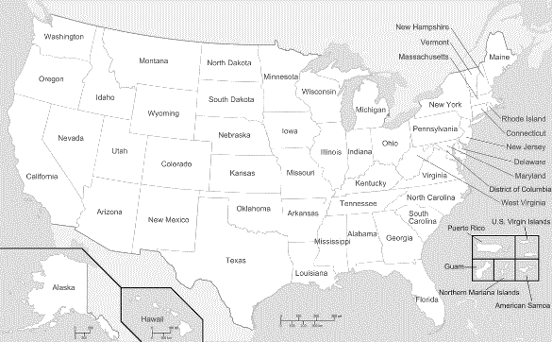
Distance Causes Challenges
Heirs may not all live on or near the land.
Distance can lead to disinterest.
(Stars are just an example showing how families can become geographically scattered.)
Notes:
Instructions: As time goes on, heirs may move to different places and no longer have strong connections to the land. Yet they are still heirs. The lack of connections may leave the land vulnerable as remote heirs may be more willing to sell their share in the land to someone outside the family.
This video (next slide) tells the story of one such family.
Time: 2 minutes
Materials: None
Handouts: None

Slide 15
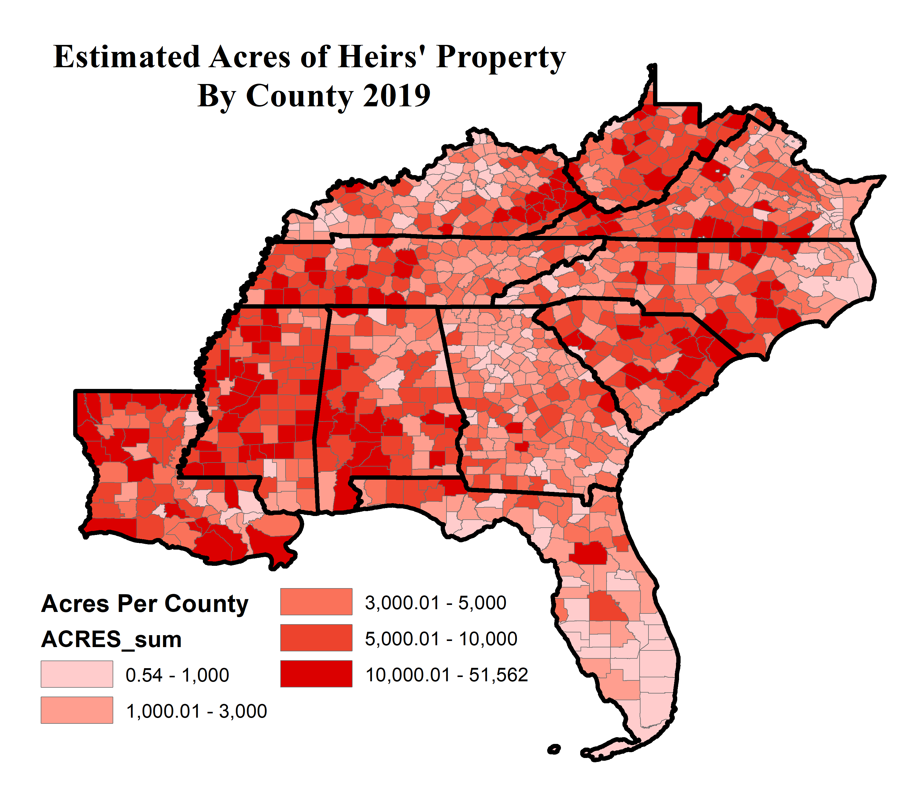
Heirs’ Property in the
Southeast
Notes:
Instructions: While there are concentrations of heir's property across the United States, African American heirs' property is found mainly within the Southeast region.
Time: 1 minute
Materials: None
Handouts: None
Citation: Carpenter, A., S. Jones and J. S. Pippin. 2016. Understanding Heirs’ Property in the Southeast. Federal Reserve Bank of Atlanta. Partner Update, March/April.

Slide 16
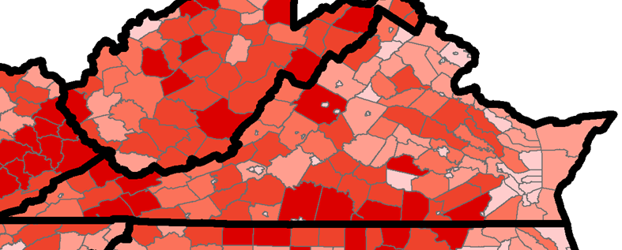
Notes:
Instructions: While there are concentrations of heir's property across the United States, African American heirs' property is found mainly within the Southeast region.
Time: 1 minute
Materials: None
Handouts: None
Citation: Carpenter, A., S. Jones and J. S. Pippin. 2016. Understanding Heirs’ Property in the Southeast. Federal Reserve Bank of Atlanta. Partner Update, March/April.

Slide 17
Fractional Ownership
The SIZE of each heirs’ fractional ownership interest depends on several factors such as:
How many generations removed is an heir from the original deceased landowner?
How many heirs can rightfully take their inheritance at a specific point in time?
Notes:
Instructions: Heirs’ property means that heirs have an undivided fractional interest in the land. Fractional here means a percentage interest as opposed to actual acreage. Note these two key factors that influence fractional interest. These are discussed further in the next slide.
Time: 1 minute
Materials: None
Handouts: None

Slide 18
Impact of Heirs’ Property:
On Heirs & Community
Affects how land is managed
Land cannot be developed to full potential
Potential Loss of Property
Lost opportunities for improvements
Notes:
Instruction:
This slide shows how limits in use of heirs’ property land ultimately impact the community.
Examples of management decisions:
Timber harvesting and reforestation
Farm planting and harvesting
Mineral rights
Mortgages and other loans
USDA programs
Conservation easements
If heirs’ property affects how land is managed, and it cannot be developed to its full potential, then the community loses on potential taxes based on increased development and improvements. This impacts:
Roads and Bridges
Fire and Safety
Sanitation
Education
Time: 5 minutes
Materials: None
Handouts: None

Slide 19
Intestate: Dying without a Will
Distribution
Children
Time
Taxes
State law determines distribution
Court appoints children’s guardian
Takes longer to settle estate
May have tax consequences
Notes:
Instructions:
If someone dies without a will, it is called “intestate,” which means
The state uses established rules to determine distribution.
Dying intestate can add significant time to the process of distribution.
If your children are minors, the court will appoint a representative to look after their interests.
Dying intestate may have tax consequences.
Time: 10 minutes
Materials: none
Handouts: none

Slide 20
SUMMARIZING
Up to this point we know that…
Heirs’ property land is held without clear title
Heirs’ property is passed from one generation to the next due to lack of probated will or judicial proceeding
Heirs’ property has limited investment potential and is at risk for loss through legal and other means
Notes:
Instructions: Review these summary points to prepare for the next section.
Time: 1 minute
Materials: None
Handouts: None

Slide 21
Business Structures Taxes & Title to Real Property
Notes:
Instructions: Understanding how your property is titled is vital to drafting your will. This next session explores some things to consider.
Time: 1 minute
Materials: none
Handouts: none

Slide 22
Placing Property in an Entity – An Alternative Approach to Physically Dividing Property
Your property can be conveyed to a trust, corporation, limited liability company or other entity
Prior to your death – Seek advice on property taxes (if homestead)
Upon death if designated in your will
Be sure to seek a lawyer’s assistance.
Notes:
Instructions:
Using a trust or business entity can avoid partition and the decedent can determine the use and management of the property after his or her death.
Generally, interests in entities could include shares of stock in a corporation, membership interests in a limited liability company, partnership shares/units in a partnership, etc.
Some trusts are created by a will. Other trusts are created prior to the owner’s death by a trust instrument.
Prior to your death:
If the trust is created prior to the owner’s death, the owner will deed their property to the trust. Trusts are managed by one or more trustees who have broad discretionary powers. Prior to the death of either spouse, your lawyer may help you convey property to a trust, corporation, limited liability company or other entity.
NOTE: Seek advice as to the effect on property taxes, if the property is your homestead.
If property is placed in an entity prior to your death, your will provides for the interests in the entity you created to be left to a spouse or children.
Upon death through a will:
Upon death, if you have kept the property in your name, a will may place property in a trust for the benefit of a spouse or children.
Time: 5 minutes
Materials: none
Handouts: none

Slide 23
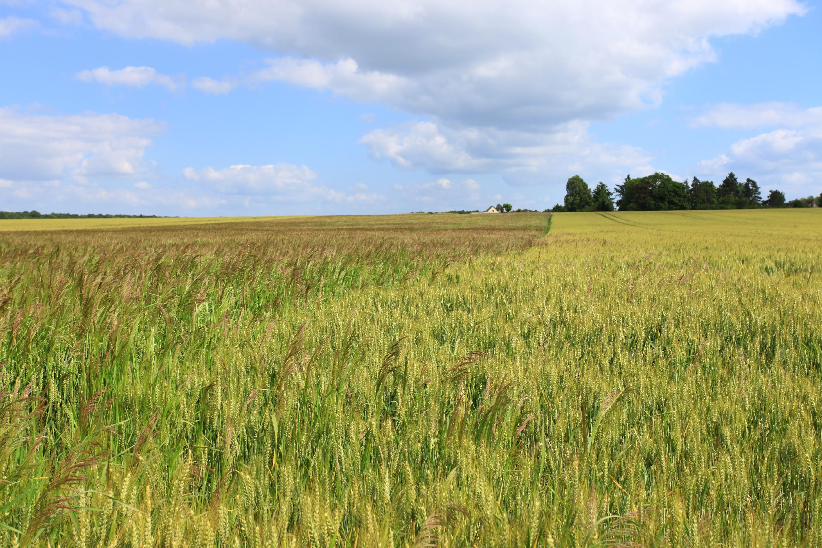
Examples of Legal Structures to Hold Land:
Trusts
Limited Liability Company (LLC)
Tenant-in-Common Agreement
Notes:
Instructions: Now we’re going to talk about different legal structures for holding land. We’re talking about this so you have some familiarity with the terms; obviously, it’s not your job to give legal advice, but it is important that you have some sense of what these things are.
Time: 1 minute
Materials: none
Handouts: none

Slide 24
PREVENTING HEIRS’ PROPERTY
Notes:
Total Session Time: 3 hours
Instructions: Have this slide up when participants enter the room.
Time: 1 minute
Materials: none
Handouts: none

Slide 25
Heirs Property Check Sheet
Complete the VSU Heirs’ Property worksheet with participants
Notes:
Instructions: Ask the participants the questions on slide. Asking these questions will help you get to know where the audience is and what they are interested in learning.
Time: 4 minutes
Materials: none
Handouts: none

Slide 26
Basics of Estate and Succession Planning
Notes:
Instructions: This is a section divider to introduce the next topic.
Time: 1 minute
Materials: none
Handouts: none

Slide 27
What are the costs of not having an estate plan in place?
Notes:
Instructions. Ask the participants the question on the slide. Most people are focused on the monetary and time costs of getting a will in place. This will help people think about the hidden costs of not having one.
Probate can be very costly
Incapacitation and the need to obtain guardianship can be expensive
Higher taxes without a trust
Time: 3 minutes
Materials: none
Handouts: none

Slide 28
What are the reasons for not having an estate plan in place?
Notes:
Instruction: Ask the participants the question on the slide. This will give you an understanding of obstacles your audience feels or experiences.
Time: 2 minutes
Materials: none
Handouts: none

Slide 29
What Are the Main Reasons You Don’t Have a Will?
Source: https://www.caring.com/caregivers/estate-planning/wills-survey/
Notes:
Instruction: Discuss the slide. This will give you an understanding of obstacles your audience feels or experiences.
Time: 2 minutes
Materials: none
Handouts: none
Source: https://www.caring.com/caregivers/estate-planning/wills-survey/

Slide 30
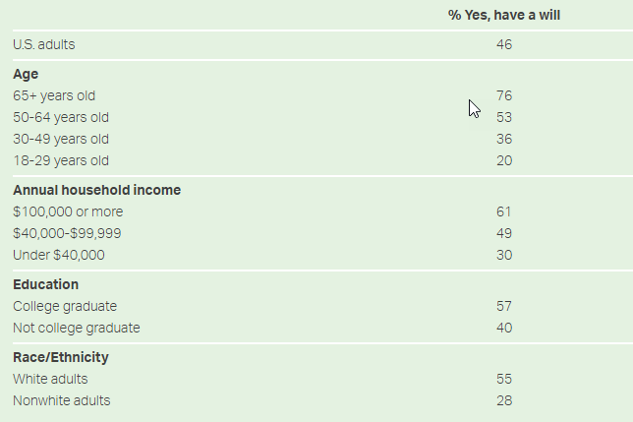
Percentage of Americans Having a Will by Subgroup
Do you have a will that describes how you would like your money and estate to be handled after your death?
Source: https://news.gallup.com/poll/351500/how-many-americans-have-will.aspx
Notes:
Instruction: Discuss the slide.
What do you notice?
What surprises you?
Time: 2 minutes
Materials: none
Handouts: none
Source: https://news.gallup.com/poll/351500/how-many-americans-have-will.aspx

Slide 31
We All Need an Estate Plan
This session will focus on questions of property.
Estate planning guides your loved ones in decision-making in the event you are no longer capable or if you die.
Notes:
Instructions: Most people take care of their property while living, but many of these same people make no plans for its management after their death.
Despite concern for families, friends, and property during their lifetimes, they fail to provide guidance when it is most needed—when they are no longer present to make decisions.
As a result, the state decides how their belongings will be distributed. Therefore, everyone should consider having an estate/succession plan.
Time: 1 minute
Materials: none
Handouts: none
Source: https://www.investopedia.com/terms/e/estateplanning.asp

Slide 32
How comfortable are you talking about death?
1 2 3 4 5 6 7 8 9 10
“Anything that’s human is mentionable, and anything that is mentionable can be more manageable. When we can talk about our feelings, they become less overwhelming, less upsetting, and less scary. The people we trust with that important talk can help us know that we are not alone.”
-- Mr. Fred Rogers
Notes:
Instructions: Ask the participants the question on the slide and discuss.
While not in the survey of reasons people do not have a will, when talking to people casually about establishing a will, they often mention being worried that if they write a will, it is like they are inviting their death. Many people are not comfortable talking about death.
Helping people reframe the topic of death is very powerful. Once the audience shares, you can ask about upsides about talking about death, including that it helps us live more fully.
This quote from Mr. Rogers is applied to a scene in “A Beautiful Day in the Neighborhood” movie about Mr. Rogers’ life.
Discussion: What do you think about this quote as it relates to estate planning?
Time: 5 minutes
Materials: none
Handouts: none

Slide 33
Updating Your Will
When someone named in your will dies
When circumstances change
Notes:
Instructions:
Updating a will after the death of someone named is important to prevent later difficulties. For instance, if a child is deceased and the will conveys property to more than one unnamed grandchild, it creates a risk for difficulties arising from lack of unanimous consent. Updating wills after the death of a spouse or child may avoid this problem. Similarly, a change in circumstances surrounding people or things named in the will should lead to the will being updated.
Time: 2 minutes
Materials: none
Handouts: none

Slide 34
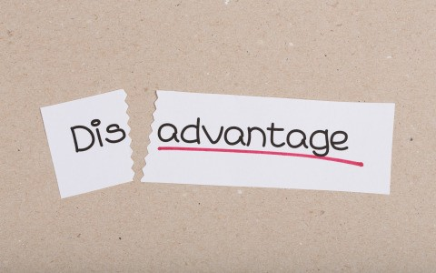
Placing Property in an Entity – An Alternative Approach to Physically Dividing Property
Advantages:
Property stays together in one undivided tract.
Unanimous consent is not required for most management actions
There may be a prohibition on sale of property or interests
Disadvantages:
Restrictions may make sale of a person’s interest difficult.
Disagreements on management decisions may cause friction.
Notes:
Instructions:
Discuss these advantages and disadvantages of placing property in an entity
Advantages include:
The property stays together in one undivided tract and is managed by a trustee (if held in a trust) or a board, manager(s) or general partner(s) if held in another entity.
This does not require unanimous consent for most management actions.
There may be a prohibition on sale of property or interests.
Disadvantages include:
Restrictions placed on transfer of interests in the entity may make a sale difficult when a child needs to sell for health, financial or other personal reasons.
Disagreements over management decisions made by others may cause family dissention.
In entities other than a trust, unanimous consent of the owners of an interest in the entity may be required to sell the property or place a mortgage on it. General day-to-day affairs are decided by majority vote of the board of directors (for a corporation), the manager(s) (for a limited liability company) and the partners (for a partnership). A holdout will usually not create a deadlock.
A common requirement may include restrictions on transfer of interest in the family-owned entities. A proposed sale may first be required to be offered to the other owners or the entity before being sold to a third-party.
Time: 5 minutes
Materials: none
Handouts: none

Slide 35
For example, if you die without a will in Virginia…
If a person dies with: | Here is who inherits:
children but no spouse | the children inherit everything equally
a spouse but no descendents or parents | the spouse inherits everything
a spouse and descendants, all of whom are descendants of the decedent and the spouse | the spouse inherits everything
a spouse and descendants, at least one of whom who is not a child of the surviving spouse | the spouse inherits one-third of the person’s estate, and the remaining two thirds is shared between the children of the decedent (whether from the surviving spouse or not)
parents but no spouse or descendants | the parents inherit everything equally
siblings but no spouse, descendants, or parents | the siblings or their descendants inherit everything equally
Intestate Succession in Virginia. Found in Heirs Property: Understanding the legal issues in Virginia, pg 4.
Notes:
Instructions: This chart shows the complexity of what could happen in just one state. State laws vary, making for a very complicated system.
Note: If participants begin asking a lot of “what if” questions about specific situations, use caution in responding. Rather remind participants that these are general statements intended to demonstrate the complexity of the situation.
Also, remember, and remind the participants, that you are not a lawyer, and detailed questions are better answered by a lawyer.
Time: 5 minutes
Materials: None
Handouts: None
Source: https://www.nolo.com/legal-encyclopedia/intestate-succession-alabama.html

Slide 36
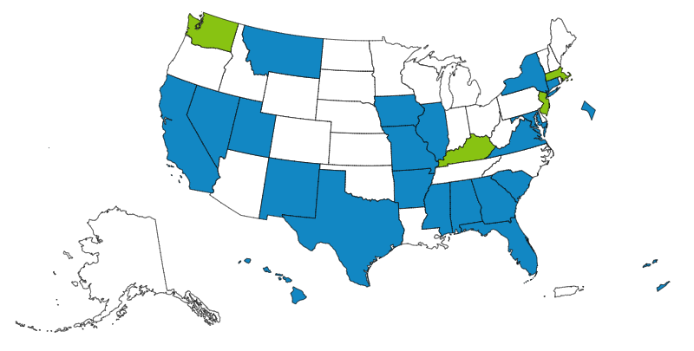
Uniform Partition of Heirs Property Act (UPHPA)
Where the Uniform Partition of Heirs Property Act has been adopted or introduced – February 2023
Uniform Law Commission site at uniformlaws.org
Notes:
Instructions: The American Bar Association’s (ABA) Section of Real Property, Trusts and Estates Law formed a task force and submitted a proposal in 2006 to the Uniform Law Commission. The Uniform Law Commission also known as the National Conference of Commissioners on Uniform State Laws worked to develop a model State statute that would address partition laws. The Uniform Law Commission approved the Uniform Partition of Heirs Property Act (“UPHPA”) in the summer of 2010. It is important to note that the Uniform Law is not effective until adopted by state legislature. This is a map of states who have enacted the Uniform Partition of Heirs Property Act, highlighted in blue. It also shows states where the UPHPA was introduced, and those states are highlighted in green.
Time: 2 minutes
Materials: None
Handouts: None
Source: https://www.uniformlaws.org/committees/community-home?CommunityKey=50724584-e808-4255-bc5d-8ea4e588371d

Slide 37
How Does the UPHPA Help?
Applies only to heirs’ property
May help heirs’ property landowners maintain their property
Provides additional protections against the forced sale of heirs’ property
Preserves the right of a co-tenant to sell his or her interest in the property
Restructures the way partition sales occur
Notes:
Instructions: This slide gives an overview of how the UPHPA helps heirs’ property owners. The UPHPA contains legal protections for heirs’ property landowners designed to address the devastating effects of partition sales while balancing the interest of all owners of the property. In order for a partition action to be governed by the UPHPA, the property in question must constitute “Heirs Property” as defined by the UPHPA.
NOTE: A co-tenant is defined as a person having a fractional ownership interest in property.
The next few slides give more detail.
Time: 2 minutes
Materials: None
Handouts: None
Source: The Uniform Partition of Heirs Property Act, Section 2. Definitions

Slide 38
How Does the UPHPA Help? Provides the following protections in partition actions:
01
Enhances Notice
02
03
Independent Appraisal
Right of First Refusal
04
Preference for Partition-in-Kind
05
Open-Market Sale
06
Partition in Kind- Dividing land into pieces of equal value for co-tenants
Notes:
Instructions: This slide gives a snapshot of the specific protections included. The following slides go into more detail.
Time: 1 minute
Materials: None
Handouts: None

Slide 39
Enhances Notice
Co-tenant requesting a partition MUST:
Provide notice of the partition action to all co-tenants; and
Post a conspicuous sign on the heirs’ property.
Notes:
Instructions: The new sales procedure is designed to mirror the traditional procedures real estate brokers use when they market properties and provides enhanced notice regarding the partition sale. In addition to sending notice of filing of a partition action to all known heirs' who are locatable, the plaintiff shall post a conspicuous sign on the heirs' property.
The sign must state that an action for partition has commenced and list the name and address of the court.
The court may require the plaintiff to publish on the sign the name of the plaintiff and of any known cotenants.
Time: 2 minutes.
Materials: None.
Handouts: None.
Source: The Uniform Partition of Heirs Property Act, Section 4: Service; Notice by Posting.

Slide 40
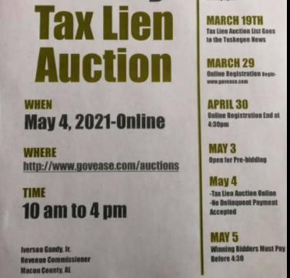
Tax Sales
In Virginia:
The property owner must receive notice at least 30 days prior to initiating any judicial proceeding for a tax sale of the property.
The taxpayer has the option of asking the tax collector to enter into a payment agreement over a period not to exceed 60 months.
If the owner fails to redeem before the date of sale, the taxing authority puts the property up for sale.
The successful bidder on the property obtains title to the property and owns it from that point forward.
Notes:
Instructions: If you don’t pay your property taxes, the county auctions your tax bill and interest in a “bid down” process starting at 12%. If you don’t reclaim your tax lien within three years, which includes repaying the tax bill plus interest, then the land will go to the bidder.
There are always investors who look for these tax sales as a way of either getting land for just the tax value, or as a way to invest their capital at a high interest rate.
This means that all heirs/landowners, particularly absentee landowners, need to keep track of who is paying the property taxes on their heirs' property.
Time: 10 minutes
Materials: None
Handouts: None

Slide 41
Open-Market Sale
If the property is sold, it must be listed with a licensed real estate broker for sale at a price no lower than the court-determined value for a reasonable period of time.
The court may order a sale by another method if the open market sale is unsuccessful.
Notes:
Instructions: If the property is to be sold, it must be listed with a licensed real estate broker for sale at a price no lower than the court-determined value for a reasonable time. If another method will produce a better price, the Court may waive the open-market sale procedure.
Time: 1 minute.
Materials: None.
Handouts: None.
Source: Uniform Partition of Heirs Property Act, Section 10. Open-Market Sale, Sealed Bids, or Auction.

Slide 42
Effect on Liens
A partition or sale for division under the UPHPA doesn't mean you won't be responsible for existing mortgages or liens on the property. You will likely still be obligated to satisfy/pay them.
Notes:
Instructions:
This is important to note to participants
Legal language per Alabama Code:
“A partition, sale or other disposition of property pursuant to this chapter shall not affect or displace a mortgage or other lien on the property and shall not affect or displace the obligations of any person who is a party to the mortgage or other lien or who is obligated on any note or other agreement secured by the mortgage or other lien.” Ala. Code 35-6A-12
Time: 1 minute
Materials: None
Handouts: None

Slide 43
Critical Step to determine how the UPHPA can help you…
Speak with an attorney licensed to practice law in the state where your land (real property) is located about the UPHPA, its enactment in your state, and how it can help resolve your heirs’ property issue.
Notes:
Instructions: Be sure to emphasize that for your audience to understand how the UPHPA can help resolve their heirs’ property issue, it is important to speak with an attorney licensed to practice law in the state where the land (real property) is located.
Points to discuss include:
The ethical rules concerning representing a family or o one or more members
Whether UPHPA is enacted in your state, and if not, how the heirs’ property law is governed
How the UPHPA or other applicable real property law may help resolve your heirs’ property issue.
Time: 1 minute
Materials: None
Handouts: None

Slide 44
Title to Real Property: Examining Title
A title certificate or report will generally specify the:
Record title owner(s)
Type of shared ownership, if applicable (e.g., Joint Tenancy with Survivorship Rights or Tenancy in Common)
Legal description
Tax parcels and status of payment
Encumbrances (e.g., easements, covenants)
Title claims or unresolved issues
Title should be examined by a lawyer or a title company.
Notes:
Instructions: This slide depicts the types of information typically found on a title certificate or report. A few things to note:
Generally, only the surface title is examined (not mineral title).
The examiner reviews all instruments for a period of years required by the law of the applicable state.
Type of shared ownership - your interest may be limited by the form of the deed to you if you hold title by:
Joint Tenancy with right of survivorship (typical for husband and wife) that vests title in the survivor of the decedent.
Tenancy in Common (typical for siblings) that vests title in the heirs of the decedent at law (in the absence of a will).
Time: 5 minutes
Materials: none
Handouts: none

Slide 45
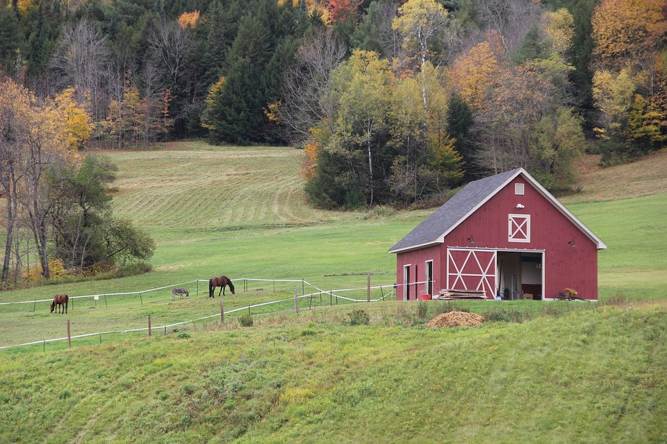
Maintaining Property as Heirs’ Property through Current Marketable Title
After title is examined, the names and percentage interests of each family member should be determined.
Record. Title should be updated to reflect current ownership and percentage interest according to the law of the states where the property is located which may include:
Affidavit of Heirship
Probate of wills
Administration of Estates
Judicial Determination of Heirship
Notes:
Instruction: Discuss these key elements involved in keeping a title current.
Time: 5 minutes
Materials: none
Handouts: none

Slide 46
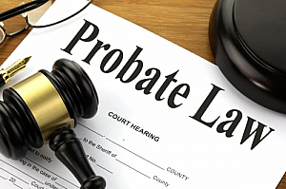
Probate Process
This Photo by Unknown Author is licensed under CC BY-SA
Process of validating a will
Executor files in local court
Not all wills must be probated
Probate will likely be needed if:
Real estate is involved
Beneficiaries are minors
Disputes over asset distribution occur
Assets are complex and high in value
Will is not written well
Notes:
Instructions: This slide describes the process for validating a will. It also describes situations where probate likely will be needed. Each state will have a specific process for estate administration/succession. Some states file copies of probated wills in the land records. Other states have the executor or administrator file a deed on behalf of the estate.
Time: 3 minutes
Materials: none
Handouts: none

Slide 47
Independent Appraisal
Unless all parties agree on the value of the property, the court determines the property’s fair market value.
A disinterested, licensed real estate appraiser in the state where the property is located is usually appointed or the judge may determine that the value of the property does not justify the expense.
Notes:
Instructions: Co-tenants can agree on the value of the property. If; however, all co-tenants do not agree on the value of the property, the court will order a disinterested licensed real estate appraiser to determine the fair market value of the property.
Time: 1 minute
Materials: None.
Handouts: None.
Source: Uniform Partition of Heirs Property Act, Section 6. Determination of Value.

Slide 48
Right of First Refusal or Buy-Out Provision
Any co-tenant not seeking partition by sale may buy the interest of the co-tenant(s) seeking partition by sale.
If more than one co-tenant wants to purchase the property, the court will divide the seller’s interest between the buyers according to their existing ownership shares.
Notes:
Instructions: The Right of First Refusal or Buy-Out Provision allows a co-tenant who did not request a partition by sale to purchase the property. Any cotenant who does not request a partition sale may purchase the share of the cotenants who petitioned the court for a sale. If two or more cotenants want to purchase the property, the court will divide the seller’s interest between the buyers according to their existing ownership shares.
Time: 1 minute.
Materials: None.
Handouts: None.
Source: Uniform Partition of Heirs Property Act, Section 7. Co-tenant Buyout.

Slide 49
Maintaining Property as Heirs’ Property through Current Marketable Title (cont’d.)
Advantages
Keeps family current as to names and percentage of ownership of family members
Keeps relationships between family members
Disadvantages
Must be updated upon the death of each heir
Does not address disabilities (incompetence) during lifetime
Does not prevent an heir from selling their fractional interest
Does not prevent any heir or purchaser from seeking partition of the property
Notes:
Instruction: Discuss the advantages and disadvantages of this approach using the talking points on the slide.
Time: 3 minutes
Materials: none
Handouts: none

Slide 50
Granting a Spouse or a Child a Life Estate
One spouse/parent may prefer to leave real property as a life estate to a spouse or a child in the event of circumstances important to that parent. Examples include:
Planning for property management if a spouse needs to go to a nursing home after inheriting.
Ensuring a child receives the property after the death of a spouse.
Providing for the care of someone with special needs.
Allowing someone earning their livelihood from the property (farm/ranch) to remain there.
Your lawyer should advise you on rights/obligations of a life estate based on the state laws where the property is located.
Notes:
Instructions:
One spouse/parent may prefer to leave real property as a life estate to a spouse or a child in the event of circumstances important to that parent.
A life estate may be limited so as to require the holder to live on the property for a specified number of months each year if there is a concern that commitment to a nursing home or other facility would not enable the holder to manage the property. The property could be managed by others in order to keep the income stream benefitting the nursing home resident. This may have implications on eligibility for the government benefit.
A life estate ensures the parent that the children receive the property after the death of the person holding the life estate. For instance, if property solely owned by one person is first left by that person to their spouse, the surviving spouse may later remarry and change their will or for other reasons cut a child out of their will (as allowed by law).
Life estates may provide for a child with special needs so that they may remain in the family home if it is in their best interest.
Life estates may also allow a child who earns their livelihood on the farm/ranch to continue living there for their life.
Your lawyer should advise you as to what rights/obligations pass under a life estate under the law of the state where your property is located so that you could make changes to match your desires.
In most states, a life tenant has exclusive control of the property during their life. They generally must keep property in good repair.
Time: 10 minutes
Materials: none
Handouts: none

Slide 51
Farm Bill 2018
Issues addressed relevant to heirs’ property owners:
Eligibility provisions for heirs’ property operators to obtain a farm number
Conservation and Heirs’ Property
Heirs’ Property as barrier to participation with USDA
USDA Farm Services Agency Relending Program for those seeking to resolve heirs’ property
Farmland ownership data collection
Notes:
Instructions: The Farm Bill is an omnibus piece of legislation (meaning it contains numerous pieces of legislation) that controls many farm programs coming out of USDA. It is passed every five years, and the last one was in 2018.
Enacted on December 20, 2018, the 2018 Farm Bill provides support for farmers, ranchers, and forest stewards through a host of farm loan programs, conservation, disaster assistance and other safety nets. The Farm Bill gives states some incentives to pass the Uniform Partition of Heirs’ Property Act (UPHPA), discussed in detail in Part V.
The provisions in the 2018 Farm Bill relevant to heirs’ property owners include those making certain farmers operating on the land that is heirs’ property eligible to receive a farm number and participate in U.S. Department of Agriculture (USDA) programs. The bill also requires USDA to collect and report on data related to farmland ownership, tenure, transition, and entry of beginning and socially disadvantaged farmers and ranchers.
Time: 10 minutes.
Materials: None.
Handouts: None.

Slide 52
Working with an Attorney
Notes:
Instructions: The next section explores important considerations in working with a lawyer in the planning process.
Activity: Using the role play samples as a guide, demonstrate how a visit with an attorney may go.
Time: 15 minutes
Materials: Sample Role Play Scripts
Handouts: none

Slide 53
Benefits to Working with an Attorney
While working with an attorney for an estate/succession plan is not required:
An attorney can prevent the problem of incorrect wording, or an invalid will
Incorrect wording can lead to the will being contested, which adds to:
Family turmoil
Length of time for distribution
Notes:
Instructions: Note these important benefits to working with an attorney to develop your estate/succession plan.
Time: 5 minutes
Materials: none
Handouts: none

Slide 54
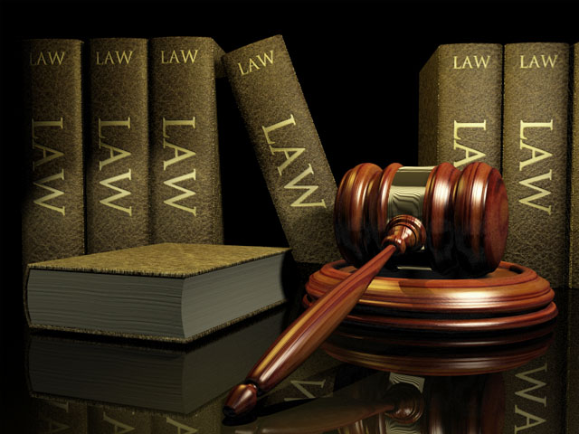
Specialty Areas of Lawyers – Just a Sample!
Trusts & Estates
Health
Family
International
Taxation
Criminal
Real Estate
Corporate
Trials and Litigation
Notes:
Instructions: This slide gives just a sample of different kinds of specialty areas for lawyers. It helps provide an idea of why finding one with the right expertise is important.
Time: 1 minute
Materials: none
Handouts: none
Source:
Here are specialties recognized by the American Bar Association for the chart: https://www.americanbar.org/topics/

Slide 55
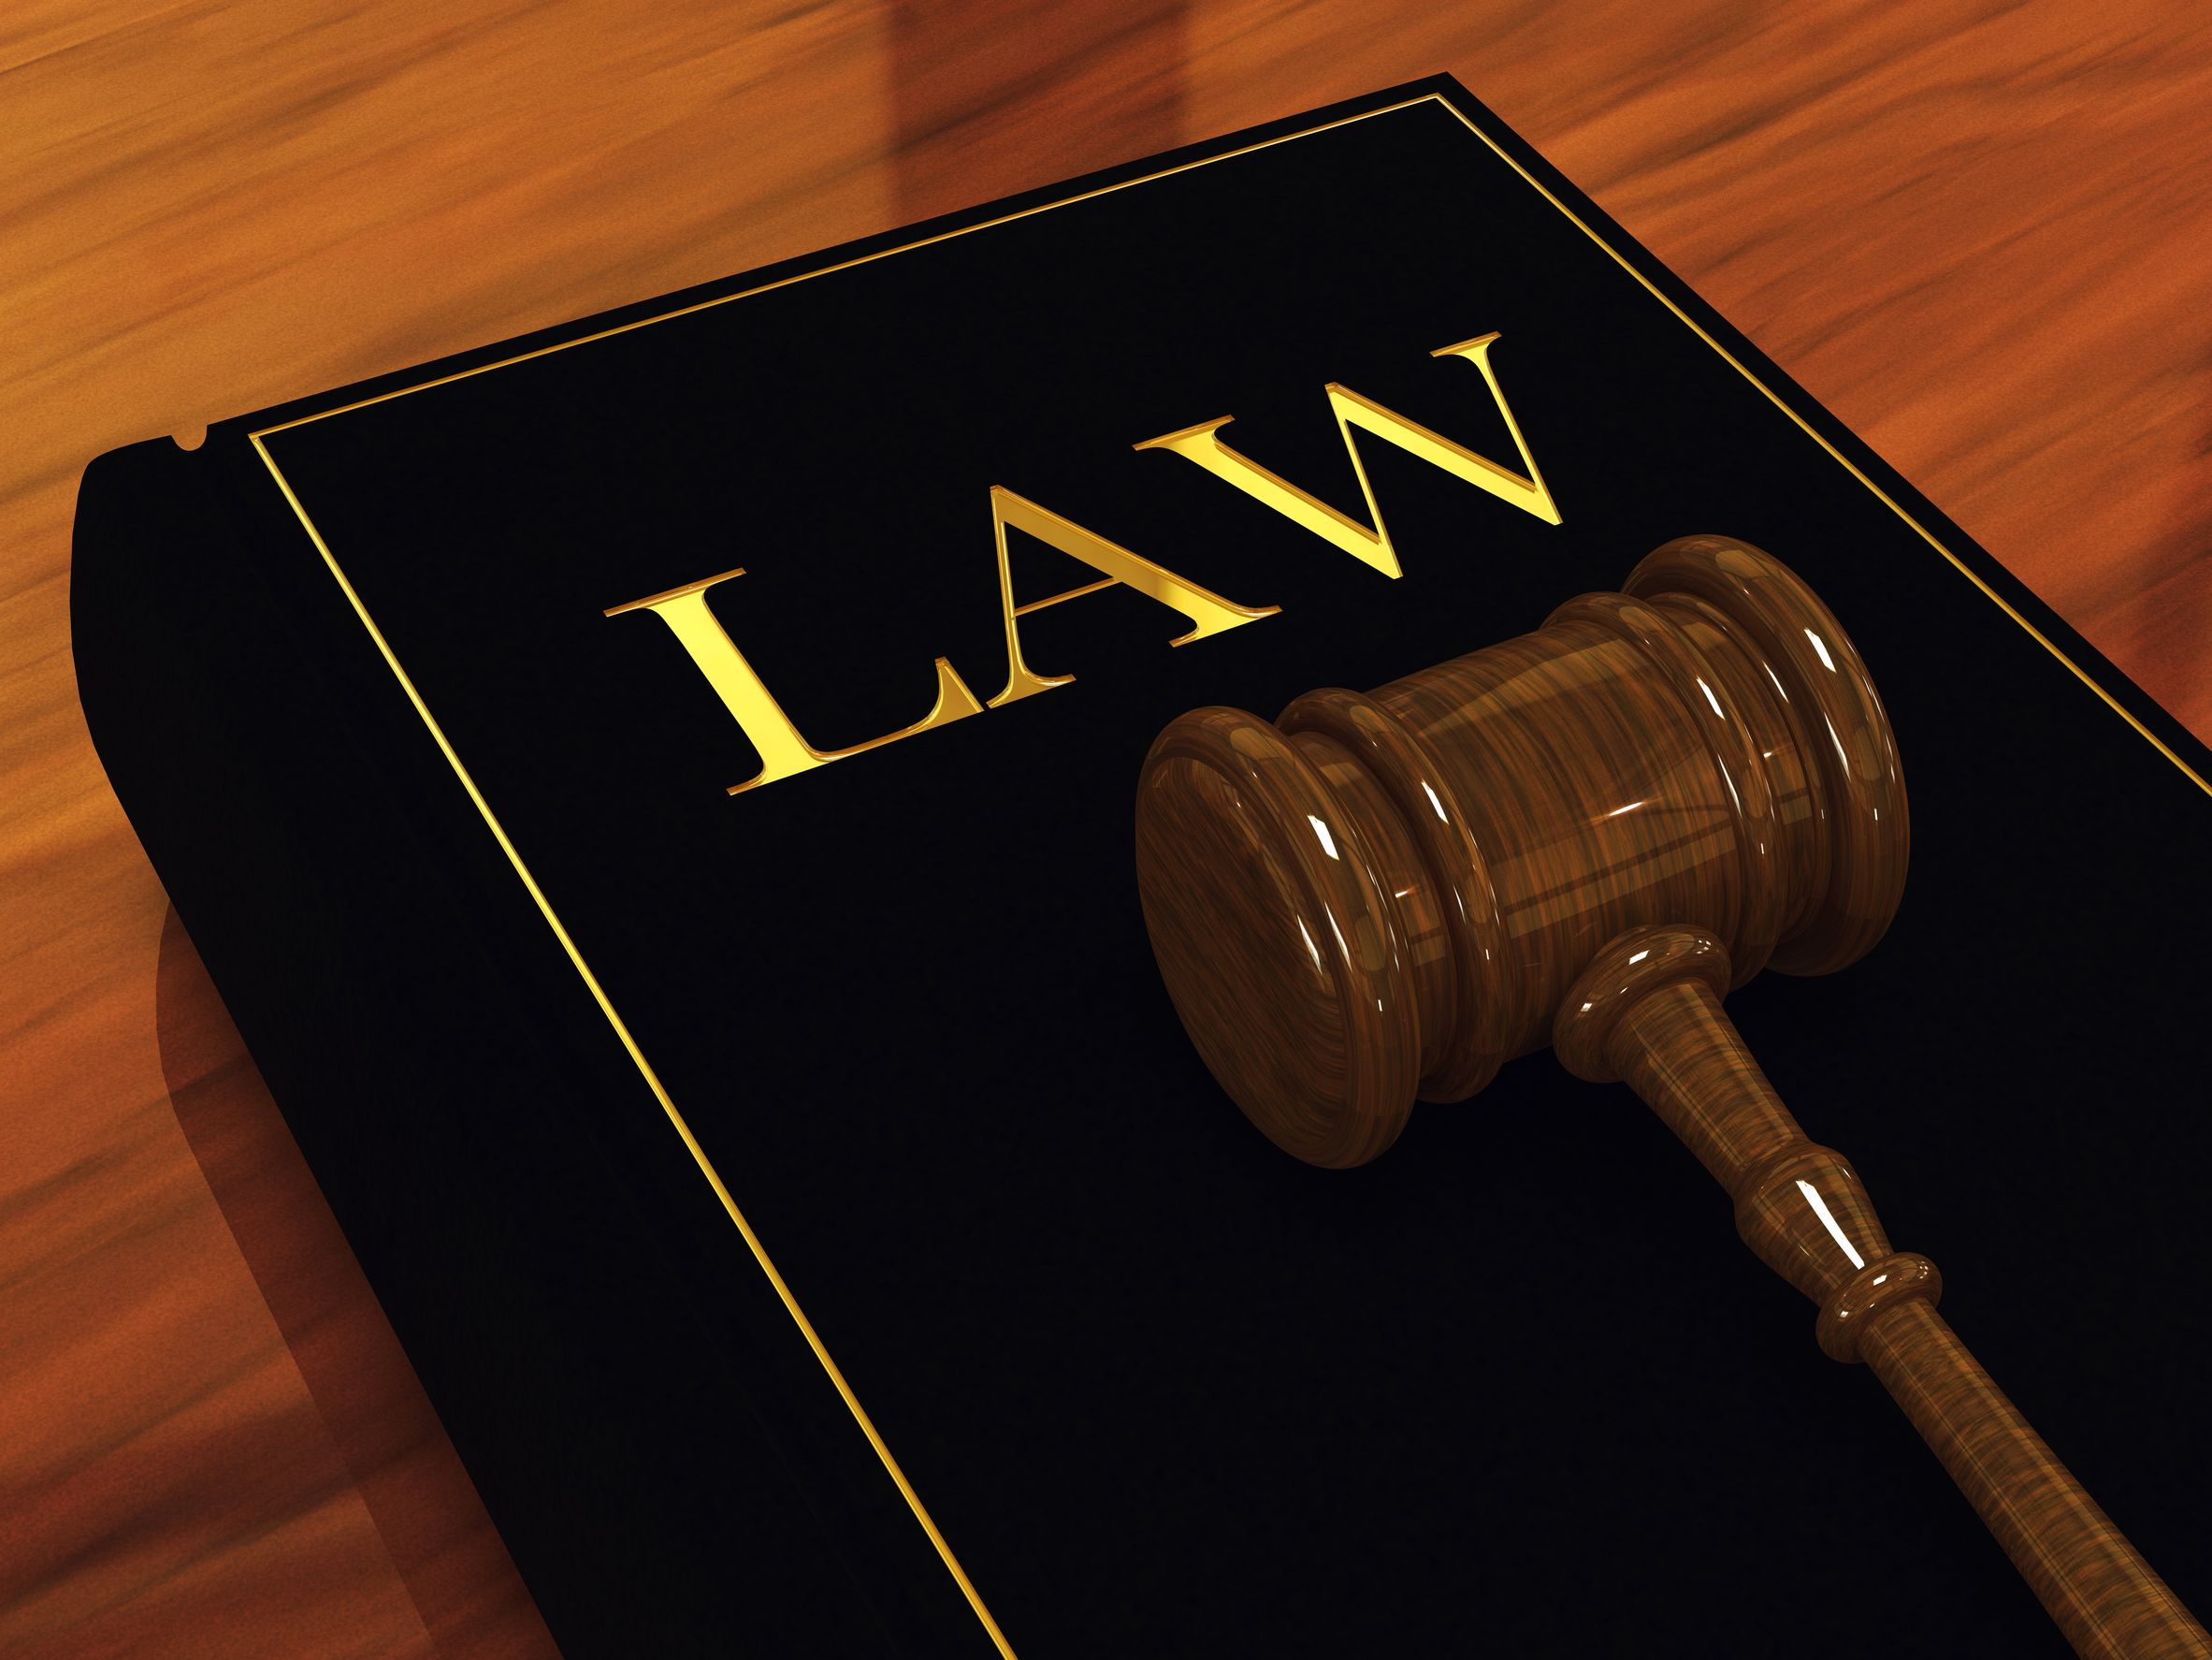
Specialty Areas of Lawyers
Not all lawyers know all parts of the law
One part is “Trusts and Estates”
Some states recognize specialization and certify lawyers.
For example: Florida bar recognizes the specialty of, “Wills, Trusts, and Estates”
Some lawyers have advanced degrees (e.g. LLM in taxation)
Notes:
Instructions: Lawyers can have a variety of specialties. This is important to understand so you are choosing one with the best training and experience.
Time: 5 minutes
Materials: none
Handouts: none
Source:
Here are specialties recognized by the American Bar Association for the chart: https://www.americanbar.org/topics/
21 specialty areas of law are listed by the American Bar Association

Slide 56
Living Will
A Simple Will or Last Will and Testament
Is a written statement that details medical treatment preferences in the event the person is not able to express his/her wishes
Includes a Healthcare Power of Attorney and Advance Health Directive in some states
No longer is in effect after the person has died
Is a legal document that designates how property, assets, and dependent responsibilities are distributed after death.
Does not take effect until a person has died
Notes:
Instructions: Explain these definitions and key differences between a living will and a simple will or last will and testament
Time: 5 minutes
Materials: none
Handouts: none
Source:
https://www.americanbar.org/groups/law_aging/resources/health_care_decision_making/power_atty_guide_and_form_2011/

Slide 57
TYPES OF WILLS
HOLOGRAPHIC WILL
MUTUAL WILL
Is usually done by a married or committed couple
Is handwritten and signed by the testator but are not witnessed (not valid in all states)
Is usually done by a married or committed couple
TESTAMENTARY WILL
SIMPLE OR BASIC TESTAMENTARY WILL
Is prepared and signed in the presence of witnesses; most recognized by the court
Lays out what you would like to have happen to your assets after you die; most recognized by the court
Notes:
Instructions: Review these different types of wills. Additional key points are:
Holographic wills are not recognized in some states. In states that permit the documents, the will must meet minimal requirements, such as proof that the testator wrote it and had the mental capacity to do so. This type of will can slow the process down and may impact other benefits as well.
After one party dies, the remaining party is bound by the terms of the mutual will.
Testamentary can be written by an individual, but having it prepared by a trusts and estates attorney tends to ensure it will be worded precisely, correctly, and in keeping with your state's laws.
A simple will is typically good for people with simple situations. A simple will is a type of testamentary will.
Time: 5 minutes
Materials: none
Handouts: none

Slide 58
Cost of a Will
Factors that influence cost:
State
Flat fee vs. time
Complexity of the situation
Simple may be as low as $500 - $600 per person.
Nationwide average is $900 - $1,500 for an individual will created by an attorney or firm.
Lawyers sometimes charge a flat fee to write a will and other estate planning documents, ranging from $300 to a more common $1,000
Notes:
Instructions: The cost of having a will developed varies widely. This slide gives some very general ideas of what someone might find locally.
Simple Will generally is around $500-$600 per person
Nationwide, the average cost for an attorney or firm to create a will is $940 to $1,500 for an individual person. Most firms will reduce their price to a few hundred dollars when adding on a second nearly identical will for a spouse.
It's very common for a lawyer to charge a flat fee to write a will and other basic estate planning documents, Ranging from $300 to a more common $1,000.
If specific tax planning is needed, the will and tax advice will be more expensive.
Other factors that can influence cost include these:
Cost will vary from state to state and from attorney to attorney.
Some attorneys charge by their time and others have a flat rate
The more complicated your situation is, the more expensive the fee
Time: 5 minutes
Materials: none
Handouts: none

Slide 59
Transferring Title by Deed
Real Property can be conveyed by deed rather than by will.
A recorded deed takes precedence over a will disposing the same property.
Deeds should be prepared by a licensed attorney.
Options for transferring include:
Conveying real property before death
Reserving or granting a life estate
Conveying title by a transfer on death deed (in some states)
Notes:
Instructions: Discuss these key points related to transferring land by deed.
These options have been noted earlier but are repeated here to weave the connections.
Conveying real property before death
Reserving or granting a life estate when conveying property to allow limited use by the life tenant prior to death
Conveying title by a transfer on death deed that transfers full title on death
Time: 5 minutes
Materials: none
Handouts: none

Slide 60
Choosing an Attorney
Like buying other products and services, you are looking for a “good fit”
Comparison shop
Ask for referrals
Look for experience in estate/succession
Be sure they are licensed in your state
Notes:
Instructions: Choosing an attorney is similar to other good shopping. This slide offers some key points to guide the decision.
Time: 5 minutes
Materials: none
Handouts: none
Source:
https://extension.tennessee.edu/publications/Documents/SP743-B.pdf
https://www.uaex.uada.edu/life-skills-wellness/personal-finance/retirement-and-estate-planning/
https://401kcalculator.net/retirement-calculator/

Slide 61
Questions to Ask
What percentage of your practice involves estate planning?
Do you have any conflicts of interests that I should know about before I hire you?
What documents will be prepared and how long will it take?
How will you keep me informed of progress?
What is the ballpark figure of my total bill and what would cause the bill to change?
Notes:
Instructions: When meeting to interview an attorney about possibly hiring him or her, listen and give the best information so that the attorney can assess your needs in the best way possible. Some questions to ask before deciding who to hire are depicted on this slide.
Time: 5 minutes
Materials: none
Handouts: none

Slide 62
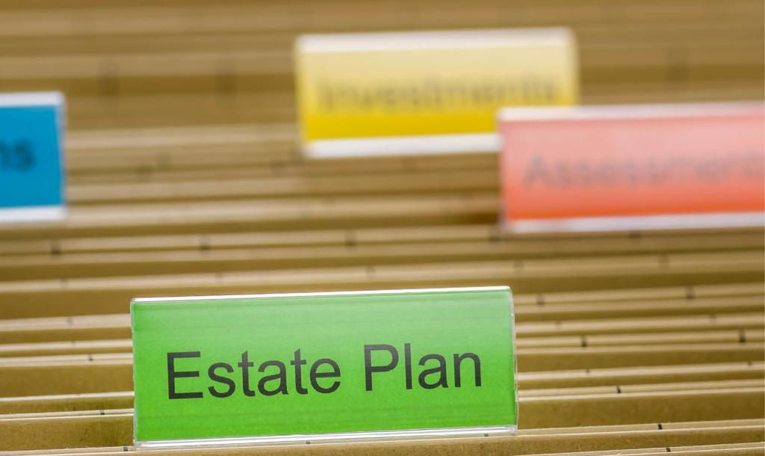
Documents to Bring
Written summary of what you plan to achieve with your estate plan
Documents with the full names and addresses for you, your spouse, children, and anyone else you plan to include in your will
Complete income tax returns, previous 3-5 years
Balance sheet: assets and liabilities owed to you
Deeds and mortgages
Detailed list of any other oral or written agreements
Marital agreements and/or divorce decrees
Beneficiary designations (insurance, retirement plans, etc.)
Prior wills, power of attorneys, any other pre-existing versions
Notes:
Instructions: Being prepared is likely to save you time and money.
Attorneys may have you fill out a form and give you a list of documents to bring with you on your first appointment, which may include:
Written summary of what you hope to achieve with your estate plan
Document with your full name and address and the full names and addresses of your spouse and children and anyone you plan to include in your will
Complete personal income tax returns for 3-5 years
Balance sheet with assets and liabilities owned by you
Deeds and mortgages
List and details of any other oral or written agreements that you have with a lender, creditor, landlord, tenant or other party
Marital agreements and/or divorce decrees
Beneficiary designations (insurance, retirement plans, etc.)
Prior wills, power of attorneys, any other pre-existing versions
Time: 5 minutes
Materials: none
Handouts: none

Slide 63
What Could Make a Will Invalid?
Each state has its own requirements for a “valid” will.
Generally, it will be invalid if it:
Was not properly executed
Was not properly witnessed (does not apply to holographic wills)
Fails to include appropriate language
Fails to address spouse and children (states vary as to the right to exclude a spouse or child)
Is a product of undue influence, fraud or was executed at a time when the testator was not competent
Notes:
Instructions: Discuss the points on the slide that can cause a will to be deemed invalid.
Time: 3 minutes
Materials: none
Handouts: none

Slide 64
Originals and Copies of Your Will
Store the original will in a safe place.
Let your executor know where the original will is stored.
Give duplicate signed copies to the executor and your attorney.
Notes:
Instructions: Ensure that your will is safe by following these three steps.
Store the original will in a safe place.
Let your executor know where the original will is stored, along with needed information such as the password for the safe.
Give duplicate signed copies to the executor and your attorney if you have one.
Time: 5 minutes
Materials: none
Handouts: none

Slide 65
Simple Will: How It May Create Similar Issues to Heirs’ Property
A simple will often leaves all assets including real property:
First, to a spouse
Second, if the spouse is deceased, equally to children.
If children inherit under this type of simple will, they hold an undivided interest in the property.
Unlike heirs’ property, the property is titled in their name
Like heirs’ property, they cannot use it without unanimous consent of all siblings involved.
Notes:
Instructions: Having a will does not mean you avoided creating issues similar to heirs’ property. Decisions have to be made by owners to manage property and put it to productive use. If property is held jointly by children, all the children as owners must consent to the use of the property. This may lead to disagreements and a deadlock.
Time: 5 minutes
Materials: none
Handouts: none

Slide 66
BENEFITS OF A TESTAMENTARY WILL
Specifies wishes for your funeral Chooses who you want to carry out your wishes (Executor) Limits inheritance disputes Clarifies the gifting of possessions and money (subject to state laws pertaining to spousal rights) Identifies who should care for your children/dependents Helps your heirs access your assets faster and easier May reduce inheritance tax
01
02
03
04
05
06
07
Notes:
Instructions: Review these potential benefits of a will.
Time: 5minute
Materials: none
Handouts: none
Source:
http://extension.msstate.edu/publications/publications/planning-your-estate-part-2-where-theres-will-theres-way
https://www.investopedia.com/articles/pf/07/estate_plan_checklist.asp

Slide 67
Tips to Avoid Heirs’ Property Issues in a Will
Put in writing how the land would be divided among spouse and children if they inherit.
Common ways to divide:
Physically divided into separate parcels for each person using valid legal descriptions.
Financially divided based on equal value of parcels by a process specified in the will.
Ask your lawyer to advise you on:
How to provide for the payment of debts and taxes so the property division is not affected by claims of creditors or required tax payments.
What is needed in terms of a temporary process to manage the farm, ranch or forest to avoid interruption in the business.
Notes:
Instructions: Review these tips for handling property distribution among multiple children. Additional talking points are below:
Physical division of property may require a survey.
Properties of the same acreage may have different values. For example, some properties having higher value are those having greater road frontage, more fertile soils, having utilities present, etc. Thus, some choose to have the property divided after death based on equal value of parcels (perhaps divided by an appraiser or other person) .
Sometimes, if an appraiser or other person is asked to divide property after the death of the property owner, they might first divide the overall property into pieces of equal value (not necessarily equal size) and then there may be a drawing where each child obtains a parcel at random.
Your lawyer should advise you on:
How provide for the payment of debts and taxes so the property division is not affected by claims of creditors or required tax payments
What is needed in terms of a temporary process to manage the farm, ranch or forest to avoid interruption in the business
Other problems are created if the children are under the age of majority when they inherit the property.
Time: 5 minutes
Materials: none
Handouts: none

Slide 68
Easement Option for Heirs
Notes:
Instructions: This is a section divider to introduce the next topic.
Time: 1 minute
Materials: none
Handouts: none

Slide 69
Takeaways
Not having a will results in heirs property, but having a will does not necessarily prevent heirs’ property
Heirs’ property leaves rural land vulnerable to development, sale, and unable to be utilized effectively
UPHPA in Virginia provides some protection against forced sale of a property

Slide 70
How Extension can help:
Prevention through estate planning education
Educate about the risks to families posed by being in heirs property and laws/policies designed to protect
Connect families to resources and tools for next steps in heirs’ property resolution
Notes:
Instructions: Heirs’ property impacts multiple levels from the personal/family to community levels.
Time: 1 minute
Materials: None
Handouts: None

Slide 71
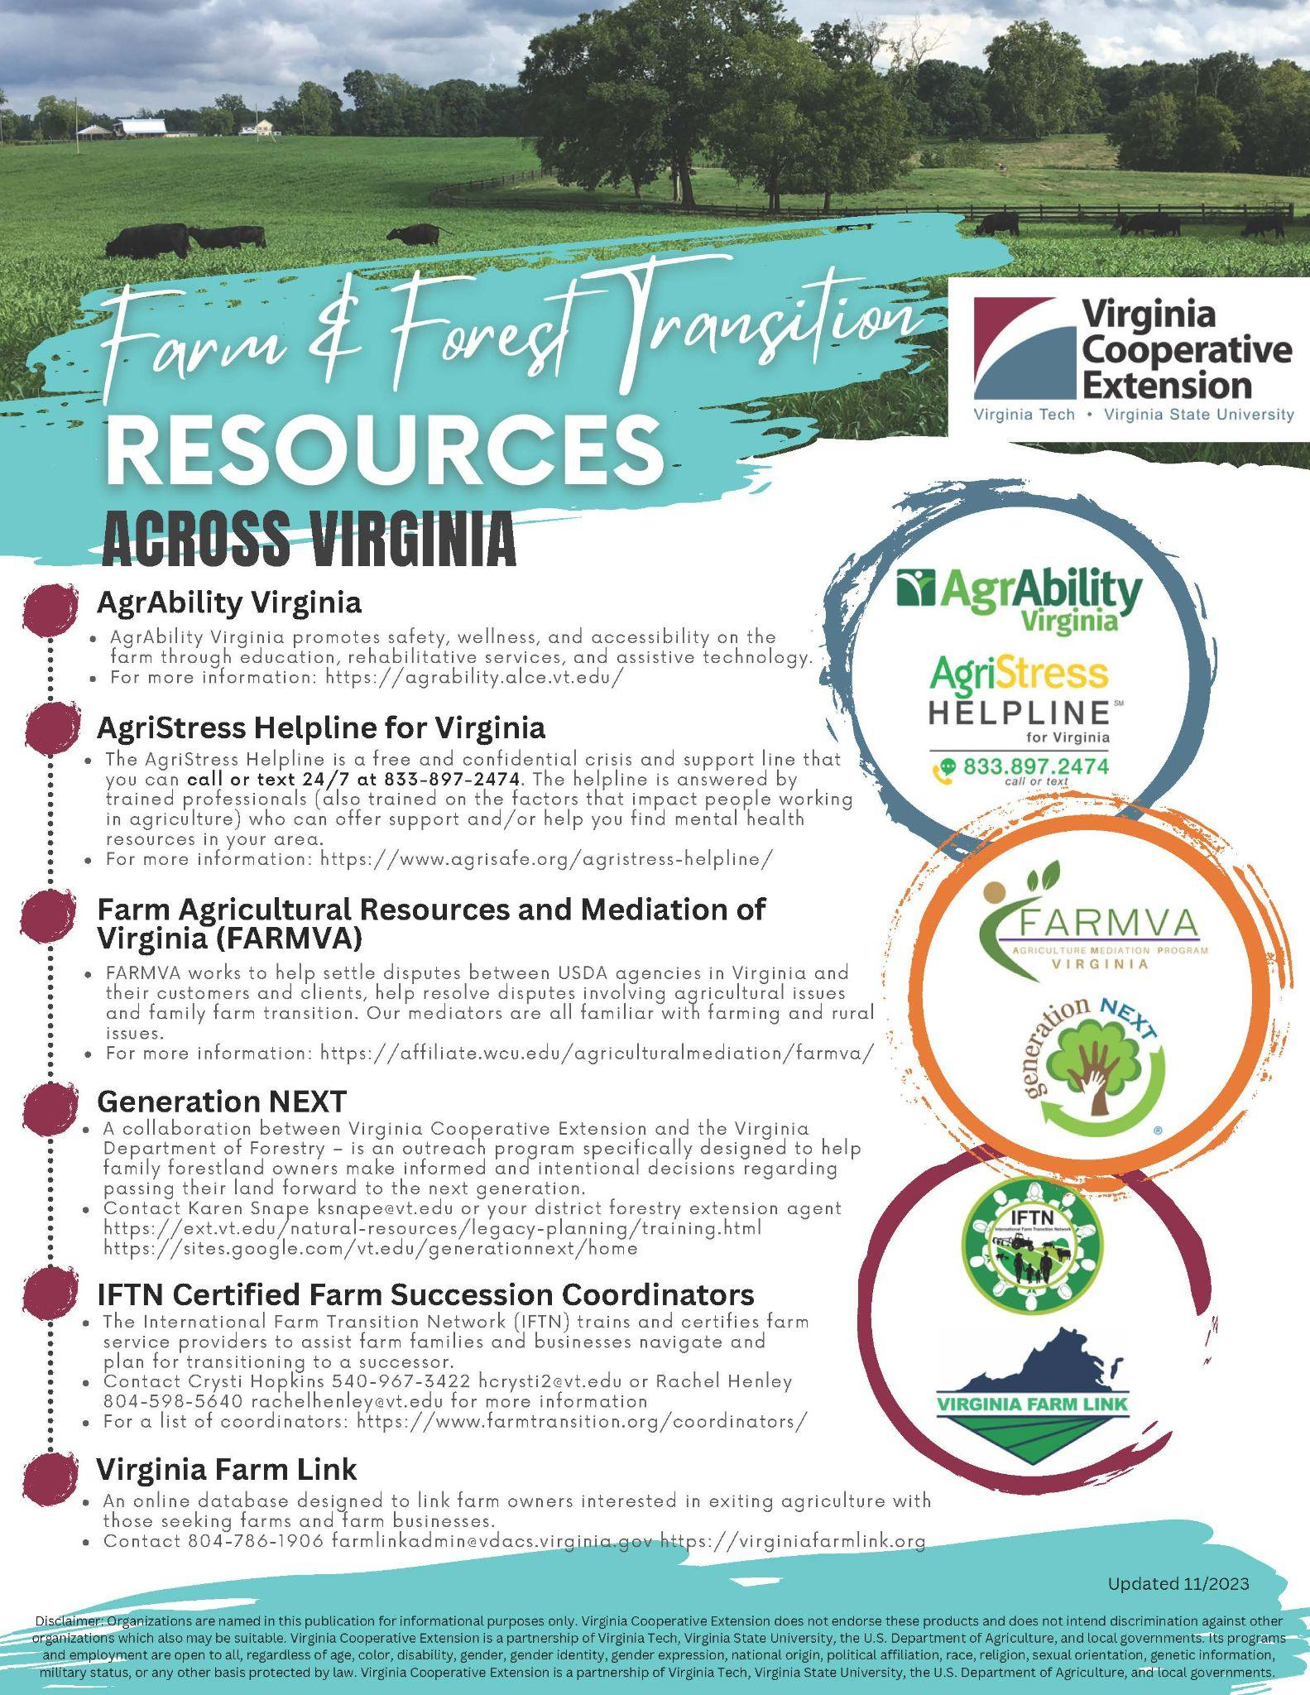
Prevention through farm transition
Notes:
Also have workshops moving across the state, contact crysti?? To participate

Slide 72
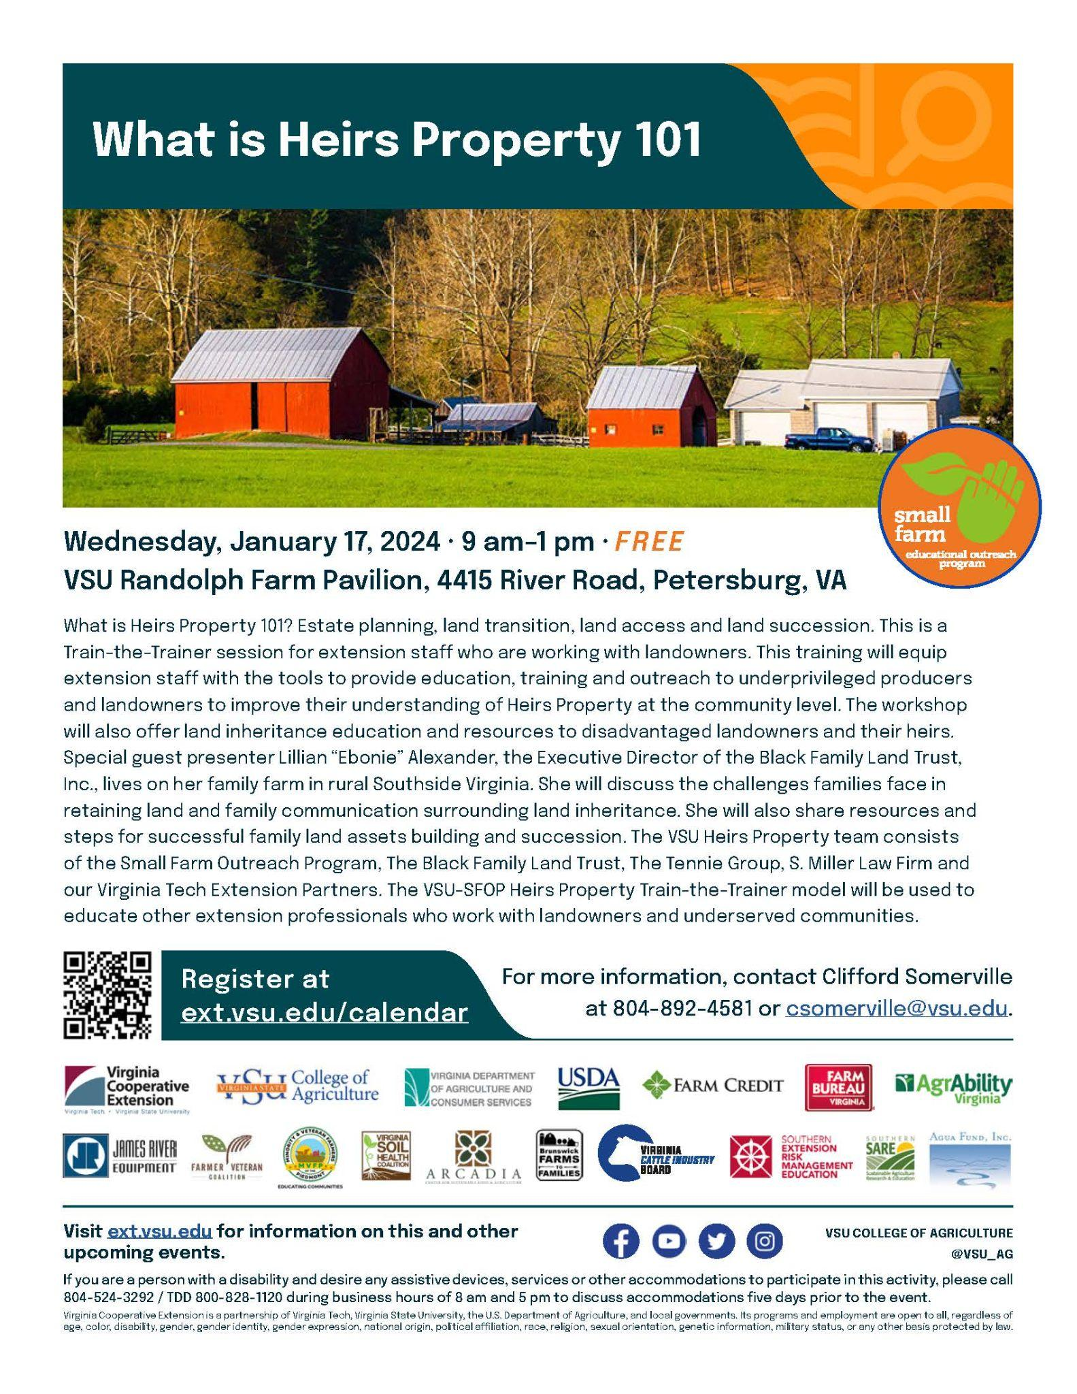
Heir’s Property Training
January 17 - Petersburg
February 21 - Danville
April 16 - Emporia
May 29 - Tidewater
July 10 - Culpepper
August 28 – VSU Randolph Farm

Slide 73
Questions and Discussion
Notes:
Instructions: Wrap up this session with any questions participants may have.
Time: 5 minutes
Materials: none
Handouts: none

